Slide 1
Preclinical statistics: enabling ethical decisions
Peter Konings
BigChem Training School
10 May 2019

Slide 2
Overview

Slide 3
Drug development pipeline
In silico
In vitro
In vivo
clinical
market

Slide 4
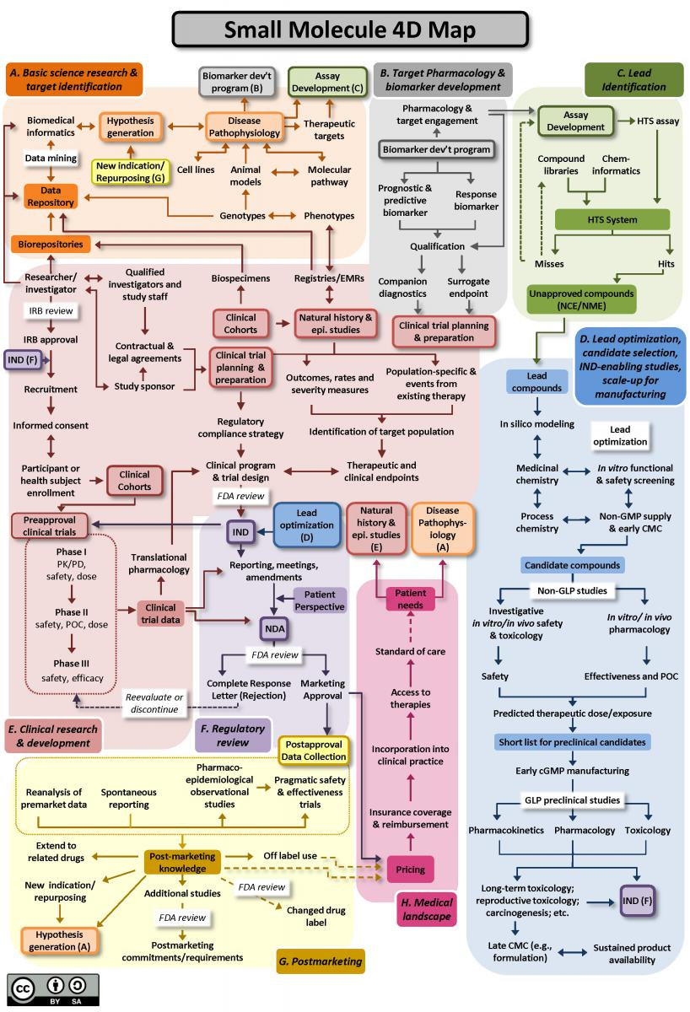
Drug development “pipeline”
https://ncats.nih.gov/translation/maps

Slide 5
Goals
Move working drugs forward as quickly and efficiently as possible
  Patient benefit
  Limited patent protection
Stop non-working/unsafe drugs as early as possible
  No harm to patients
  Free up resources

Slide 6
In-vivo models
Regulatory and ethical requirements to demonstrate efficacy and safety in animals before clinical phases
Model organisms need to be well characterized
  Specific phenotypes
  Useful even if different from humans
Rodents vs. non-rodents

Slide 7
Ethics in clinical trials
Well developed framework
  Reaction to war crimes in WW II
  Informed consent
  Voluntary participation
  Right to withdraw at any time for any reason

Slide 8
Ethics in animal testing
Differences with human trials:
  Informed consent impossible
  Involuntary enrolment
  No possibility to withdraw
3R framework:
  Replacement
  Reduction
  Refinement

Slide 9
Good Statistical Practice

Slide 10
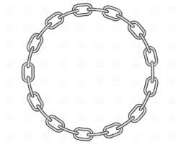
Good Statistical Practice Framework
1. Appropriate design
10. Monitoring
2.Appropriate reference groups
9. Blinding
8. Appropriate order for sample processing and analysis
3. Planned statistical analysis
4. Justification for animal numbers
7. Appropriate processing order for treatment, sampling and termination
5. Blocking
6. Randomisation to treatment groups

Slide 11
Experimental design
Good design can be analysed with simpler models
Different from human trials
Typical example:
  Negative control (sham or vehicle)
  Positive control (no treatment)
  A number of dose groups
  A reference group (Compound with known reaction)

Slide 12
Statistical analyses need to be pre-planned
Both Bayesian and frequentist inference only valid for pre-planned analyses
“Garden of forking paths”, Data dredging, …

Slide 13
Sample size calculations
Need to achieve scientific/biological goals
Minimize number of animals
Allow for dropout:
  Toxicity
  Termination for ethical reasons

Slide 14
Power
Result of test
No diff Difference
Correct!
ERROR
No diff
False +ve
95% chance
(@ 5%)
True State
ERROR
Correct!
Difference
False -ve
(@ 80%)
(@ 20%)
Power

Slide 15
Power
POWER is the probability that the test will detect a difference or effect if one is present
6 pieces of information of which we need to know 5 and estimate 1:
  Size of difference
  Variability within group
  Significance level (usually 5%)
  1 or 2 sided test
  Power (usually 80%)
  Sample size
Don’t want too big or too small group sizes
Loading control group appropriately

Slide 16
Sample size calculations
Often simulation-based
Need to specify assumptions upfront
Various scenario’s calculated; sensitivity analysis

Slide 17
Avoiding Bias: blinding and blocking
Confounders:
  Known confounders: blocking
  Unknown confounders: blinding
Single blinding vs double blinding

Slide 18
Blocking: example
Case 1
Day 1: Control Group (N=10)
Day 2: Treated Group (N=10)
Treatment difference
~
Day difference
û
Case 2
Day 1: Control Group (N=10)
Treated Group (N=10)
ü
Case 3
Day 1: Control Group (N=5)
Treated Group (N=5)
Day 2: Control Group (N=5)
Treated Group (N=5)
üü
Blocking by study day (especially useful where results are not so reproducible)
Notes:
Blocking is the identification of factors (blocks) that are likely to affect interpretation, and then balancing the allocation of treatment groups across these.
Differences between “blocks” can be adjusted for in the statistical analysis and we can see what effects are due to treatment.
Benefits:
Increases our ability to estimate true treatment effects (without confounding),
Control unwanted effects such as day effects, operators, batches of animals, instruments, cages or cage positions,
Increases confidence in robustness of results.
i.e. Makes sure that what we see as the “treatment effect” isn’t just a “day effect” or “person effect” or heavily influenced by one of these.

Slide 19
Example
Key :
Day 1
Day 2
Day
&
Treatment
effects
Notes:
An experiment was carried out to look at a compound’s effect relative to vehicle. The experiment was repeated over two days using 5 animals / group / day, and the resulting data are plotted above. (Different colours / symbols reflect the two different days.) It is interesting to note that in this example, the day-to-day variability is at least as strong as the treatment effect. There is a systematic bias between the two days, which is equally effecting both the vehicle response and treatment response.
The appropriate statistical analysis is Analysis of Variance (ANOVA). This analysis addresses whether there is a statistical treatment effect, having removed systematic differences between days.

Slide 20
Blocking
Key :
Day 1
Day 2
Day effects removed
→
Less variability for judging treatment effects
Notes:
This graph shows the same data, but the data have been adjusted to normalise across days. This has been achieved by subtracting the day average from each result and adding the overall average. The treatment mean and vehicle mean are the same as in the previous graph but the spread (ignoring day) is clearly tighter in this graph.

Slide 21
Appropriate processing order for treatment, sampling and termination
The prescribed necropsy order for the main study animals starts with the lowest numbered male animal in each group, followed by the lowest numbered female in each group, with groups appearing in the order: vehicle control, high, medium and low dose.
Animal Number | Group | Sex
1 | 1 vehicle control | M
61 | 4 high dose | M
41 | 3 medium dose | M
21 | 2 low dose | M
11 | 1 vehicle control | F
71 | 4 high dose | F
51 | 3 medium dose | F
31 | 2 low dose | F
2 | 1 vehicle control | M
62 | 4 high dose | M
42 | 3 medium dose | M
22 | 2 low dose | M
etc | etc | etc
Notes:
Appropriate processing order is necessary in cases where there may be an effect with time, e.g. the operator is getting tired; alternatively should there be a problem at a certain stage in the study - we would want this to affect all of the treatment groups the same.
- Allowing for other relevant risks e.g. Risk of errors and/or cross contamination

Slide 22
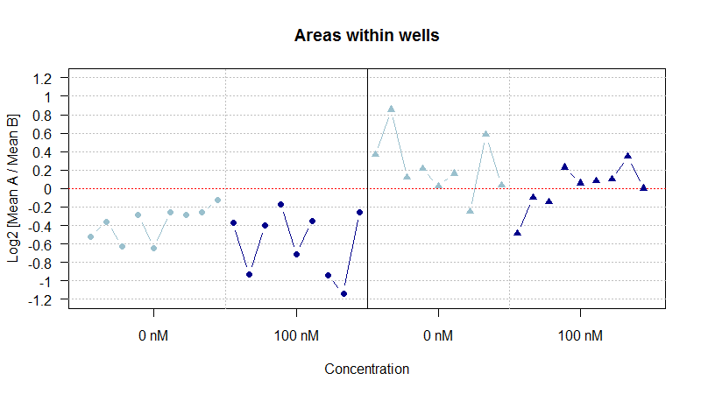
Appropriate order for sample processing and analysis
This refers to the order that samples taken from animals are going to be processed and/or analysed or assessed. Check that this order is not going to introduce bias.
The variability is affected by assessment occasion which has impact to treatment effect.
Sometimes difference for the same measured area is almost 2-fold.
Evidence of systematic effects dependent on order of assessment
Plate 1
Plate 2
Randomization of assessment order introduced to reduce bias

Slide 23
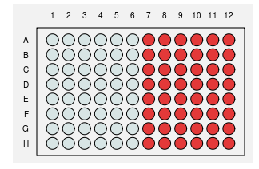
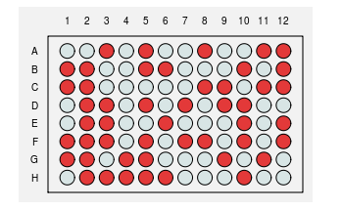
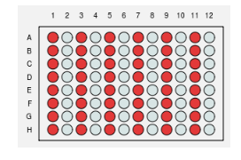



Appropriate order for sample processing and analysis
As with allocating animals / cages to study groups, and performing in-life procedures, the goal is to keep the risk of bias in the study as low as possible, and to maximise the chance of generating meaningful estimates of treatment effects, whilst processing tissues/samples
Notes:
Even if it’s not possible to randomise the plate layout (e.g. due to the risk of introducing errors), the risk of bias could still be minimized.
The numbers represent the animal no. (samples are run in duplicate in the assay)
The colours represent the treatment group (2 adjacent columns per treatment group)
What potential problems could we have here?
What could be done to avoid this?
What if there was an edge effect or a trend across/down the plate?
The same principles apply if animal samples are being processed and/or analysed in another way to get the data, e.g. if they are spun in a centrifuge, or being scored by an operator.
Appropriate processing order is in case there is an effect with time, e.g. the operator is getting tired, or in case there is a problem at a certain stage in the process - we would want this to affect all of the treatment groups the same. An example is if all of the vehicle control samples were spun in the centrifuge first, and the centrifuge broke the samples, then it would likely compromise the whole experiment. However if instead one from each treatment group had been spun in the first batch in the centrifuge, then it would have still been possible to get meaningful results from the study. As always, other risks e.g. Relative risk of errors, or Cross contamination, must be taken into account.

Slide 24
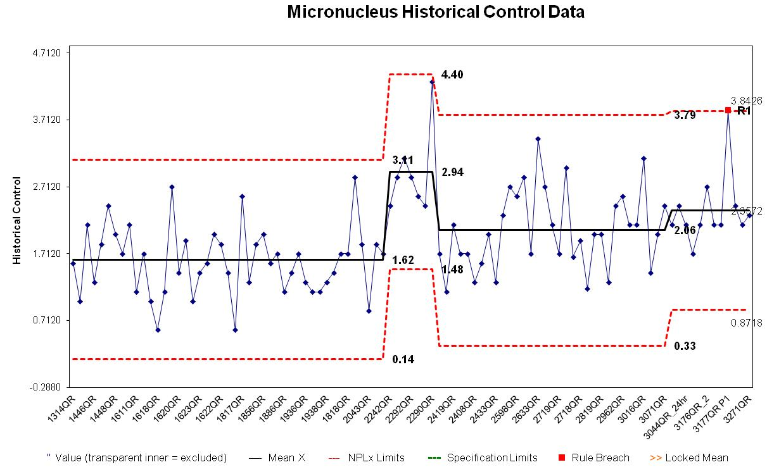
Monitoring
Assurance that the model continues to perform satisfactorily, that we will quickly spot any changes in performance and any opportunities to reduce unwanted variation.
Notes:
Control chart tool for monitoring can be used once we have data from about 10 studies. Still plot if less without using Manhattan tool.
Alongside the chart, record anything that has changed, e.g. new animal supplier, to help explain any step changes in the chart.
Variability from historical data can also be used in sample size and power calculations.
Each point represents the mean of the vehicle group for that study.
Step changes historically have usually been able to be linked with changes to the strain of rat used.
Actively used as a tool to determine validity of study.

Slide 25
Trends

Slide 26
Trends
Move away from a null hypothesis testing framework
  Estimation
  Bayesian statistics
Best practices from clinical statistics
  Pre-registration
  More complex designs
  Meta-analytic techniques
Reproducibility

