Slide 1
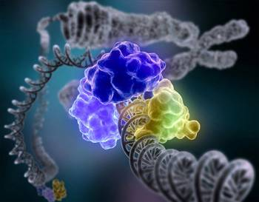
The quest for optimal design parameters in drug design thermodynamic profiling and composites
Göteborg
23 Januari 2019
Johan Ulander - AstraZeneca

Slide 2
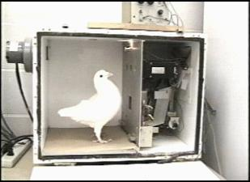
Overfitting
– The Skinner Box Experiment
Buttons to pick + random rewards → ”rain dances”
Iterative interpretations of complex data may lead to superstitious clinging to oversimplified rules

Slide 3
Representative Number of compounds in different stages of drug development
HTS – 10⁶
Focused screen 10³ – 10⁴
Hit Evaluation
cmpds 10⁴
clusters 10²
Lead Generation/Optimization
cmpds 10³⁻⁴
series 1-5
Phase 1 1 cmp
Number of existing compounds to analyze
Chemical space
10⁶⁰ ?
Different assay data-points per
compound
Out of all possible compounds – how do we find the best one?

Slide 4
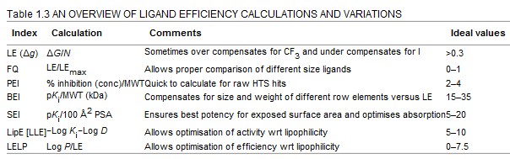
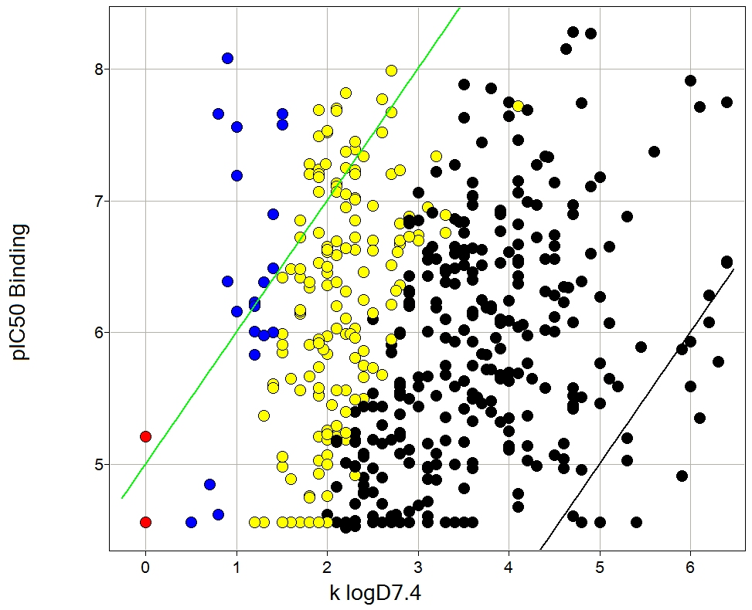
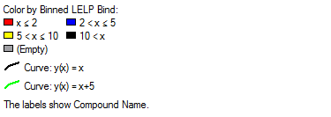
An industry of Metrics
Many composite parameters proposed to combine different optimization aspects
Ideal values should in general be taken lightly in particular when using EC50
Graham Smith Prog. In Med. Chem 2009
LLE = pIC50 – LogD is one of the most common optimization parameters
LLE=5
Parameters guiding drug discovery projects should have a clear purpose based on sound scientific arguments – not just being easy to calculate/measure
LLE=0
Notes:
Strive for scientific parameters with clear purpose
But wich parameters to choose

Slide 5
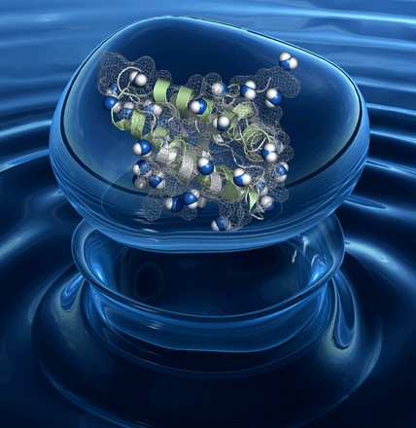
Machine-learning for Water mediated interactions led to large performance increase in protein folding predictions
water mediated contacts of absolute importance for folding predictions
Interactions generated using experimental X-ray structures of protein-protein complexes
Of absolute importance for the success of knowledge-based properties is the generation of a decoy set → normalization
Ulander/Papoian/Wolynes PNAS 2004 101: 3352-3357

Slide 6
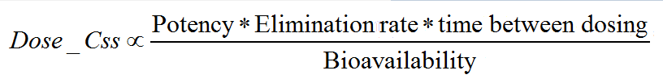
Early dose prediction – the importance of specificity
Low dose is a key optimization parameter in compound design
Safety Cost of goods Patient compliance
Minimum effective concentration
Clearance
Time between dosing
Steady state dose
Bioavailability
Potency needs to be specific towards intended target(s)
How do we determine specificity?
Notes:
This simple formula captures many of the most important principles
Low dose is key for many reasons
We are stuck with potency for a certain compound for a certain target
F can be optimized e.g. with formulation
Specificity is the key

Slide 7
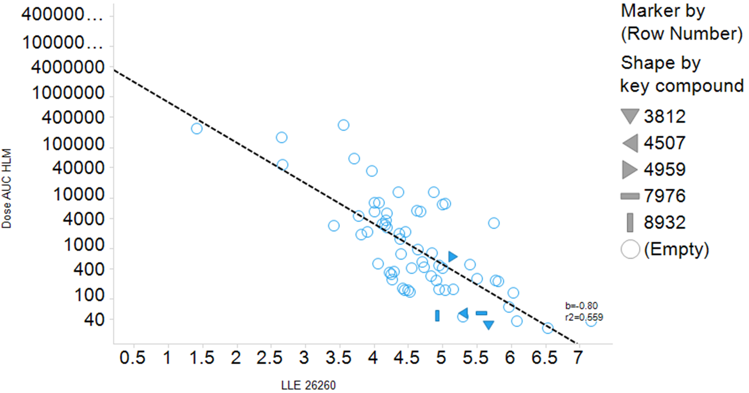
Effect of logD on ”dose composites”
$$AUC Dose proportional to IC50 u∗Clint_u$$
pIC50u
Log(Clint_u)
Log(IC50u * Clintu)
Slope~1
Slope~1
LogD
LogD
LogD
LLE correlates with Better AUC doses
pIC50u
Log(Clint_u)
Good (high) LLE
Slope~1
Slope~1
Good (high) LipMet
LogD
LogD
LLE=pKd-LogD
LLE=pIC50-LogD
LipMet=log(Clint_u)+LogD

Slide 8
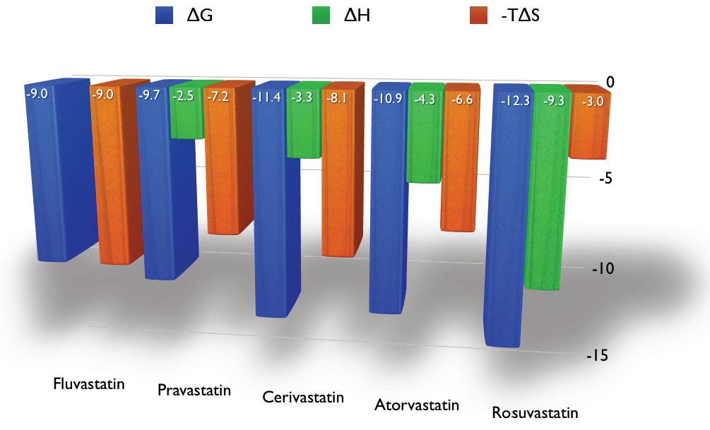
Is the thermodynamic signature a key optimization parameter?
The development from first in class to best in class as monitored by the development of statins:
Ernesto Freire:Do enthalpy and entropy distinguish first in class from best in class?
Drug Discovery Today, Volume 13, Issues 19–20, 2008, 869
Notes:
A drug molecule should bind to its target with high affinity and selectivity. Because the binding affinity is a combined function of the binding enthalpy and the binding entropy, extremely high affinity requires that both terms contribute favorably to binding. The binding enthalpy, however, is notoriously more difficult to optimize than the binding entropy, a fact that has resulted in thermodynamically unbalanced molecules that do not achieve optimal potency. In fact, with current technologies, the enthalpic optimization of drug candidates may take years and only appear in second-generation products. Within that context, it is not surprising that structure/activity relationships (SARs) that explicitly incorporate the interplay between enthalpy and entropy and accelerate the optimization process are being developed and gaining popularity.

Slide 9
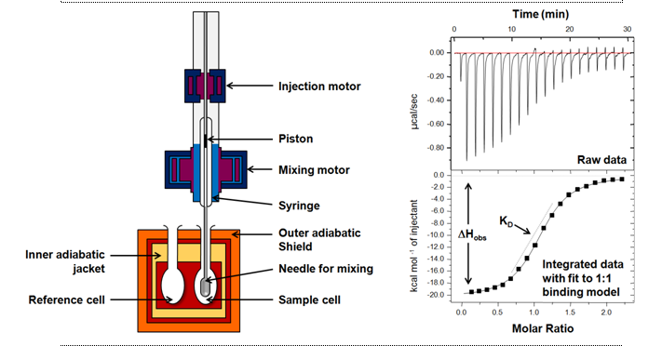
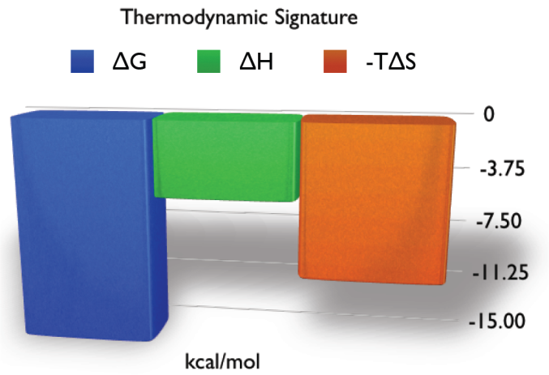
Isothermal Titration Calorimetry
ITC simultaneously determines all binding parameters (n, K, ∆H and ΔS) in a single experiment - information that cannot be obtained from any other method.
Interactions between any two molecules can be studied with ITC, including drug-target interactions

Slide 10
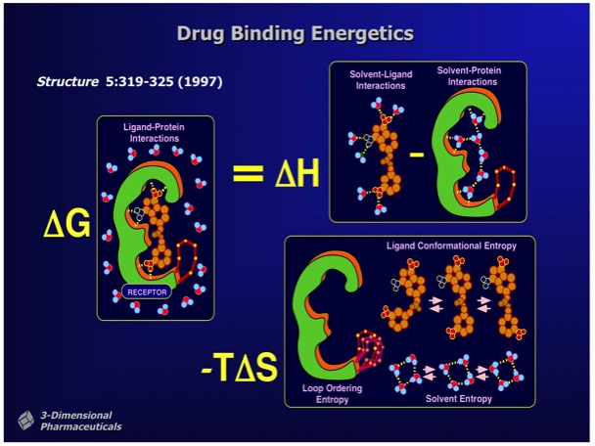
From Ray Salemme's Website
Notes:
Ligand binding sounds simple enough – ”lock and key”
Desolvation, flexibility …
Statistics → Free Energy

Slide 11
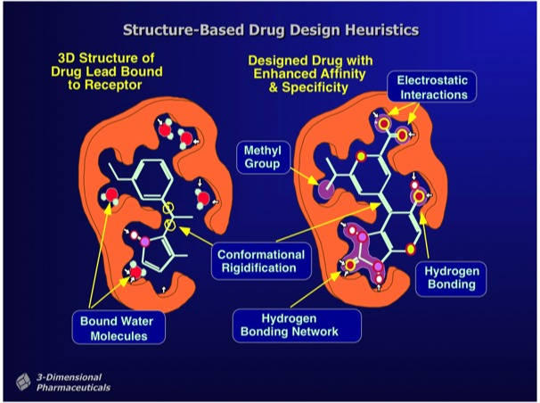
From Ray Salemme's Website
Notes:
Ligand binding sounds simple enough – ”lock and key”
Desolvation, flexibility …
Statistics → Free Energy

Slide 12
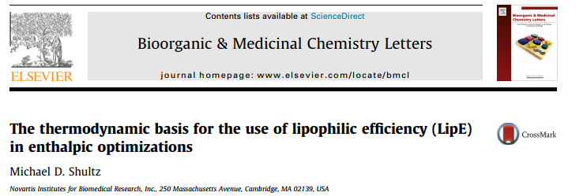
Common claims in literature
optimizing for enthalpy is the same as optimizing LLE (Lipophilic ligand efficiency)?
An enthalpically dominated binding signature indicate more specific binding interactions
LLE is a measure for specificity in ligand binding interaction

Slide 13
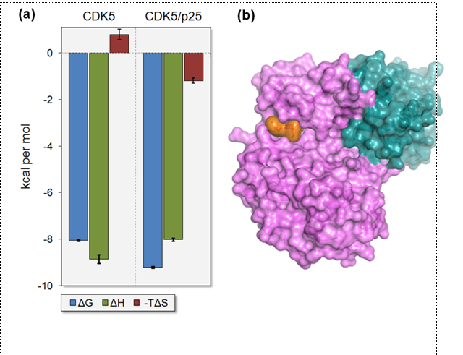
Binding thermodynamics -CDK5 with roscovitine in the presence and absence of an activator protein
Traditional view of entropy increase due to expulsion of water molecules upon binding is drastically oversimplified.
Experiments and simulations show that not only the polar interaction character but also the shape of the binding site will strongly influence the thermodynamic signature of water displacement.
Even when expulsion of water from the binding site is entropically favored, as expected from the traditional view, the net thermodynamic signature may be very different du the entropic changes of the (solvated) protein components involved.
Thermodynamic profile of the same ligand significantly different when binding to the complex rather than the isolated protein
Roscovitine binds to opposite side of p25 (green) and that CDK5 (magenta) adopts an active kinase conformation
Notes:
An example that can illustrate this is binding to CDK5 with roscovitine in the presence and absence of an activator protein …

Slide 14
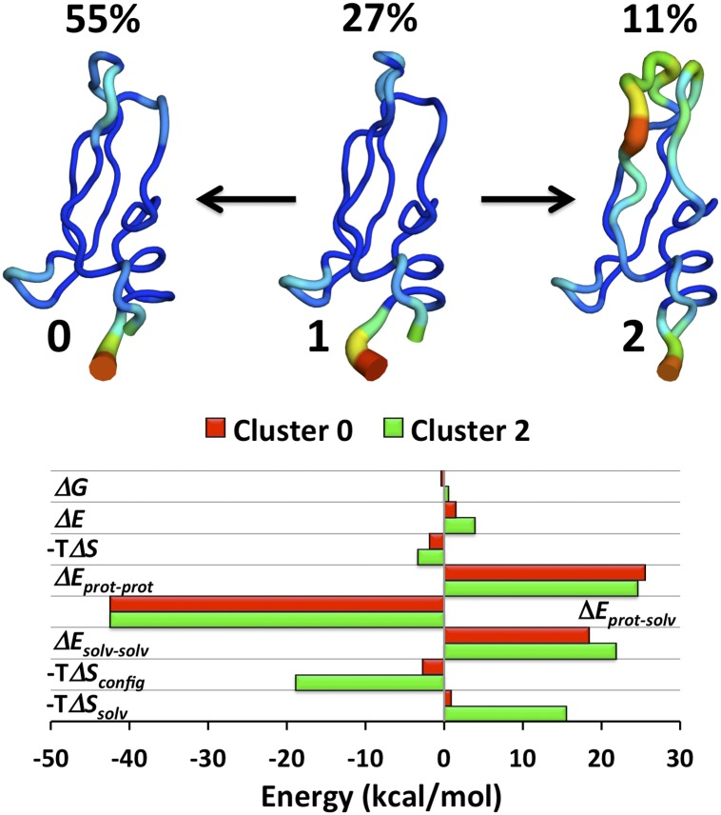
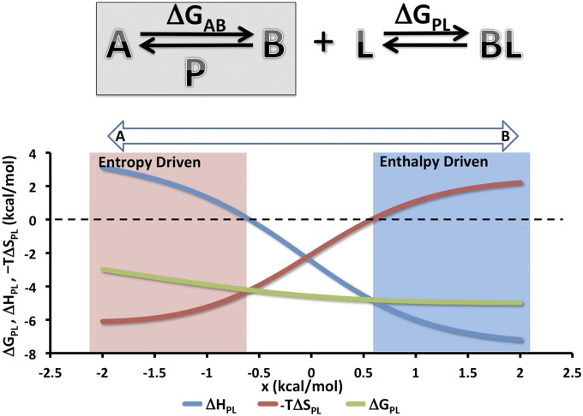
Entropy – Entropy Transduction (Gilson et.al)
Analysis of 1-ms MD-simulation of the small protein bovine pancreatic trypsin inhibitor
Very small geometrical mall perturbations selects for occupancy of different states with significantly different Thermodynamic properties
Fenley et.al. Proc Natl Acad Sci U S A. 2012 Dec 4; 109(49): 20006–20011.
Notes:
Analysis of a 1-ms molecular dynamics simulation of the small protein bovine pancreatic trypsin inhibitor reveals that its main conformations have different thermodynamic profiles and that perturbation of a single geometric variable, such as a torsion angle or interresidue distance, can select for occupancy of one or another conformational state. These results establish the basis for a mechanism that we term entropy–enthalpy transduction (EET), in which the thermodynamic character of a local perturbation, such as enthalpic binding of a small molecule, is camouflaged by the thermodynamics of a global conformational change induced by the perturbation, such as a switch into a high-entropy conformational state.
Two-state model system illustrating EET. (Upper) The protein P has two states A and B with a free energy difference of ΔG_{AB}. By construction, state B is higher in entropy and lower in enthalpy than A. Ligand L binds only state B and hence, drives P from a two- to one-state system. The overall binding free energy is ΔG_{PL}. (Lower) Overall thermodynamics of ligand–protein binding as a function of a small free energy bias, x, added to ΔG_{AB} to shift the preferred unbound state of P from state A (x < 0) to state B (x > 0). Here, ΔH_{BL} = −7.5, −TΔS_{BL} = 2.5, ΔH_{AB} = 10.0, −TΔS_{AB} = −10.0, and RT = 0.6, where ΔH_{BL} and −TΔS_{BL} correspond to the enthalpy and entropy of the ligand L binding to state B. All quantities are in kilocalories per mole.
(Upper) Representative backbone traces of the main conformational clusters C₀, C₁, and C₂ as labeled, and their percent occupancies during the simulation; color and thickness of the traces indicate rms fluctuation of the backbone (narrow blue, 0.4 Å; thick red, 3.7 Å) after structural superposition. (Lower) Bar graph of the computed thermodynamics (kilocalories per mole) of clusters C₀ (red) and C₂ (green) relative to cluster C₁. ΔE, total potential energy; ΔE_{prot-prot}, potential energy of protein; ΔE_{prot-solv}, interaction energy of protein and solvent; ΔE_{solv-solv}, potential energy of solvent; ΔG, free energy; −TΔS, total entropic free energy contribution; −TΔS_{config}, configurational entropy estimated by MIST at second order and corrected by subtraction of matched results with block-shuffled data; −TΔS_{solv}, solvent entropy computed as −T(ΔS − ΔS_{config}).

Slide 15
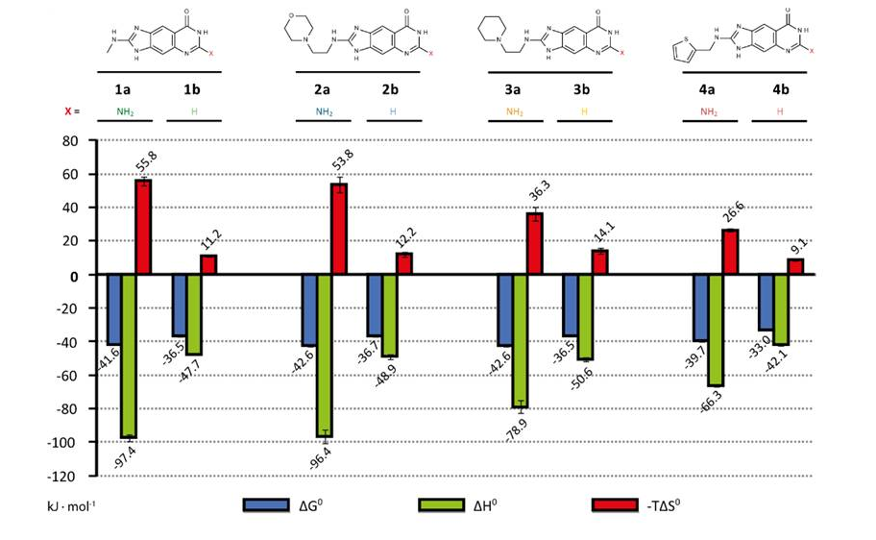
Thermodynamic profiling to identify differing binding modes
Two matched series matched with different trends → decoupling ΔH and LLE
thermodynamic signature of two classes of lin-benzopurines binding to tRNA−guanine transglycosylase
Difference in thermodynamic signatures reflects binding modes
Neeb M. et. Al J. Med. Chem. 2014: http://pubs.acs.org/doi/abs/10.1021/jm5006868
Notes:
Lead optimization focuses on binding-affinity improvement. If a flat structure–activity relationship is detected, usually optimization strategies are abolished as unattractive. Nonetheless, as affinity is composed of an enthalpic and entropic contribution, factorization of both can unravel the complexity of a flat, on first sight tedious SAR. In such cases, the binding free energy of different ligands can be rather similar, but it can factorize into enthalpy and entropy distinctly. We investigated the thermodynamic signature of two classes of lin-benzopurines binding to tRNA−guanine transglycosylase. While the differences are hardly visible in the free energy, they involve striking enthalpic and entropic changes. Analyzing thermodynamics along with structural features revealed that one ligand set binds to the protein without inducing significant changes compared to the apo structure; however, the second series provokes complex adaptation, leading to a conformation similar to the substrate-bound state. In the latter state, a cross-talk between two pockets is suggested.

Slide 16
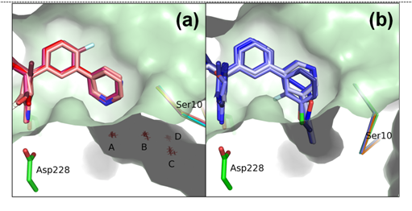
Example BACE -inhibitors
open S3 pocket
closed S3 pocket
Flexible loop form a deep water filled crevice called the S3 subpocket
Two distinct ligand-induced conformations connected to the intricate water network of the subpocket
Compounds that do not disturb the water network keep the pocket in its open conformation
Even a slight displacement of the top water will cause the pocket to collapse, releasing four conserved waters
a) Open form PDB IDs 4B78 1.5Å, 4B72 1.6Å, 4B77 1.8Å, 4B1D 1.95Å, 4B1E 1.95Å, and 4AZY 1.79Å
b) Closed form, PDB IDs 4B1C 1.95Å, 4B70 1.6Å, 4ACX 2.0Å, 4ACU 1.75Å and 4B00 1.83Å
Notes:
BACE1 features a shallow active site pocket containing the two catalytic residues Asp32 and Asp228, located between the BACE1 N- and C-terminal lobes.¹⁰⁸ The pocket is sheltered by a long flexible β hairpin flap that partially covers the catalytic side chains. A second flexible loop located on the other side of the active site near Ser10, form a deep water filled crevice called the S3 subpocket. The Ser10 loop has been seen to adopt two distinct ligand-induced conformations connected to the intricate water network of the subpocket. Compounds that do not disturb the water network keep the pocket in its open conformation while even a slight displacement of the top water (A) will cause the pocket to collapse, releasing four visible waters. In addition, the size of the pocket indicates space for at least two more water molecules (Figure 4).^{106, 10}

Slide 17
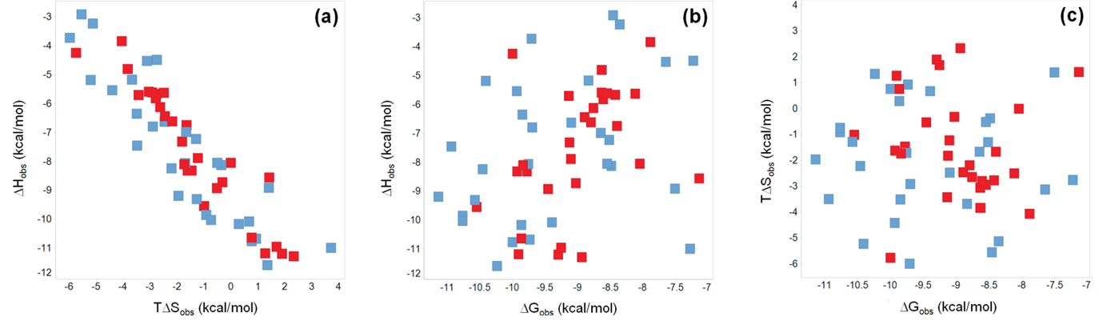
BACE - ITC Data
ΔH vs TΔS
ΔH vs ΔG
ΤΔS vs ΔG
Ligands bind to S3 pocket
Colors by S3 pocket shape- Red (open) and Blue (closed)
The thermodynamic behavior appears similar for both systems

Slide 18
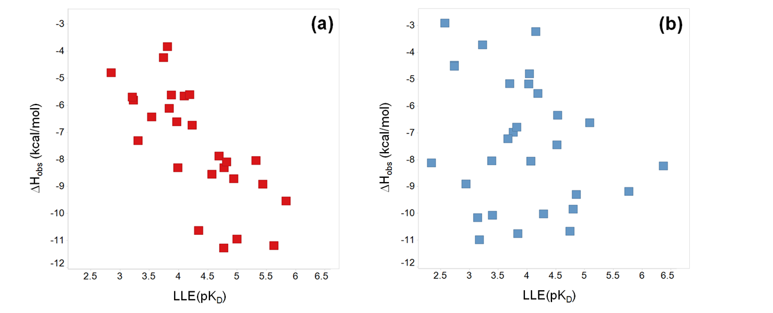
Enthalpy vs Lipophilic ligand Efficiency
Example BACE
open
closed
Both Enthalpy and LLE are often used as measures of specificity of binding
Open and closed binding modes differ in Enthalpy/LLE profile
Many suggestions in literature that optimizing for LLE and ΔH is equivalent
Such assumptions assumes ΔS dominated by ligand desolvtion
Notes:
LLE and DH is clearly not the same
Which one to choose – does any of the reflect more suitable drug-target interactions
Which one is more specificity related?

Slide 19
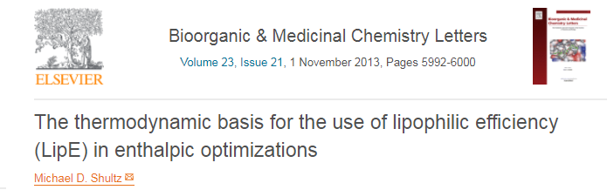
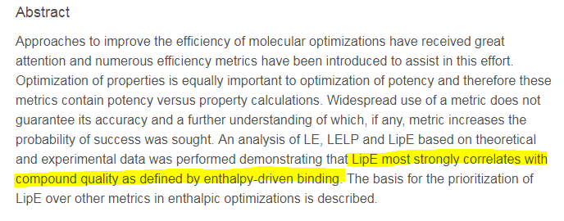

Slide 20




spurious correlations when comparing Enthalpy and LLE
$$pK_{D}=pK_{H}+pK_{S}$$
$LLE=pK_{D}−LogD=pK_{H}$ +$pK_{S }−LogD$
$$pK_{H}$$
x+y
x
$$LLE$$

Slide 21
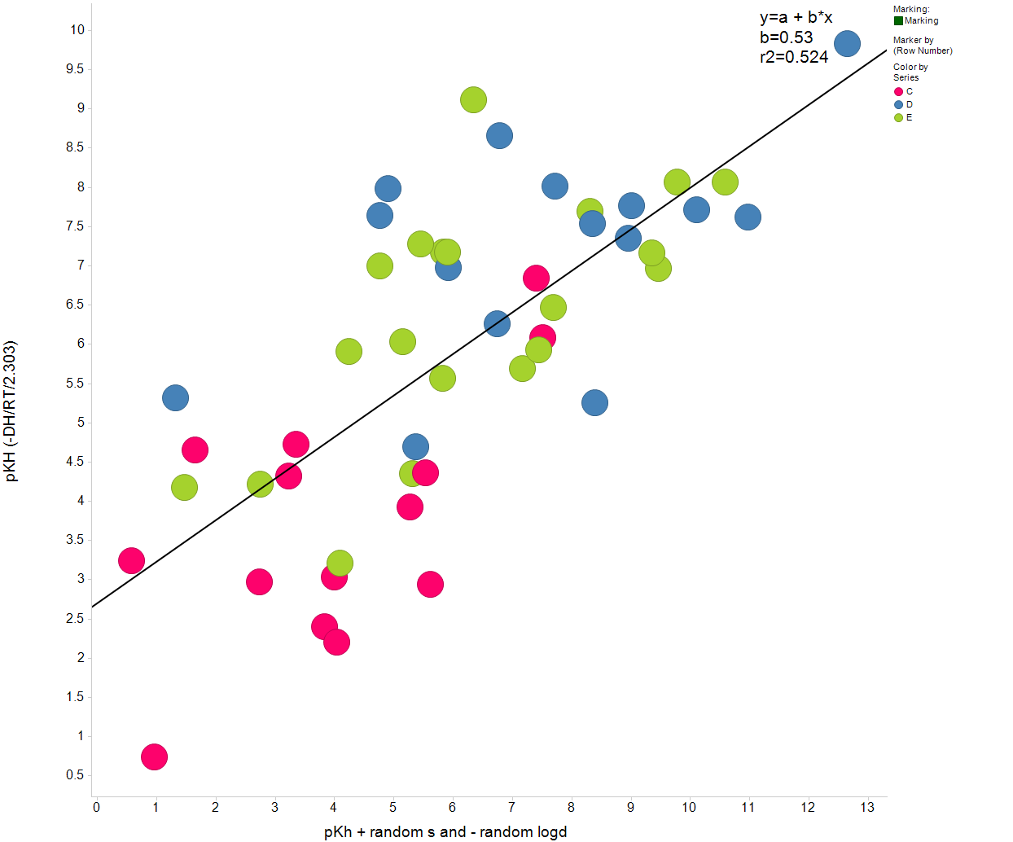
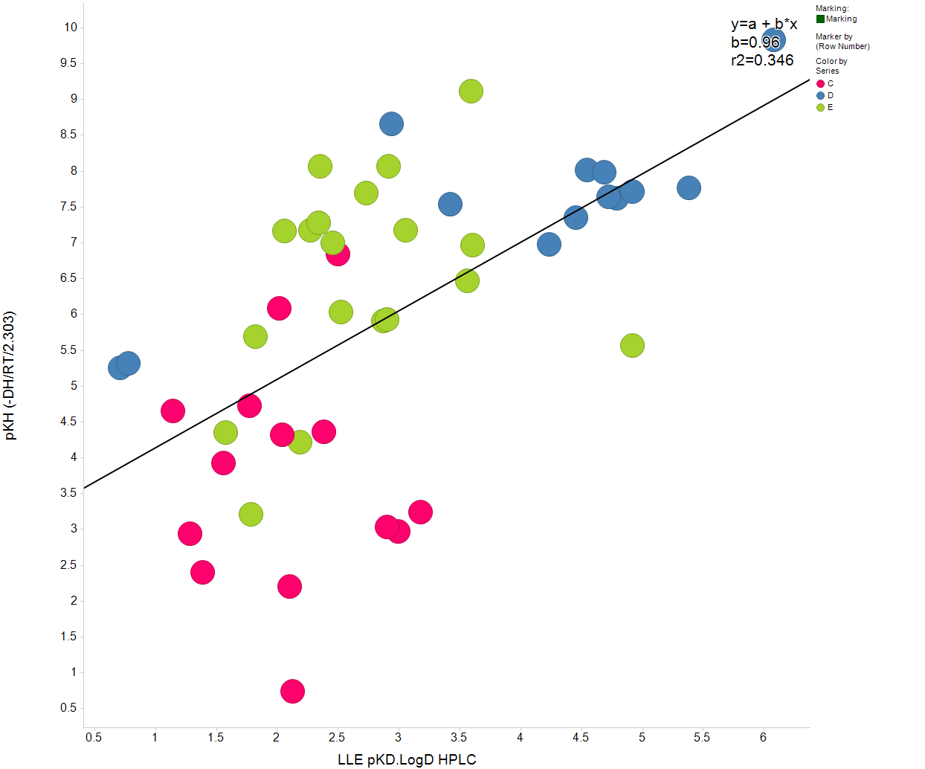
Are the LLE-DH correlations artifacts?
Enthalpy is a component in LLE → artificial inflation of
”A” below illustrates a simulation of the range of the effect for project X
”B” the actual experimental correlation smaller due to cancelling effects
A
B
pK_{H}=-ΔH/RT/ln(10)
R²=0.52
R²=0.35
A ) pK_{H} vs pK_{H +} random numbers with variation as logD and pK_{s}
B ) pK_{H} vs LLE
LLE= pK_{H} + pK_{S} - logD
LLE (random) = pK_{H} + (0.5-rand)*Range_pK_{S} – (0.5-rand)*Range_logD

Slide 22
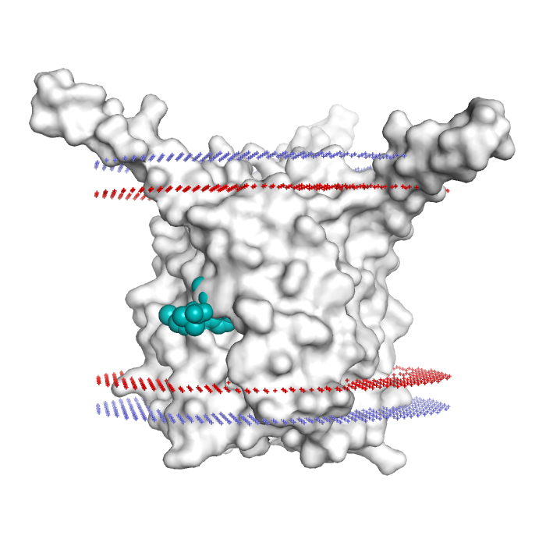

FLAP: 5-Lipoxygenase activating protein
FLAP Inhibitors binding site situated in middle of membrane region
ClogP>7
AZD6642
Compounds need not be highly lipophilic to enter
Inside membrane electrostatic interactions are less shielded and long range
PDB FLAP structure 2Q7M

Slide 23
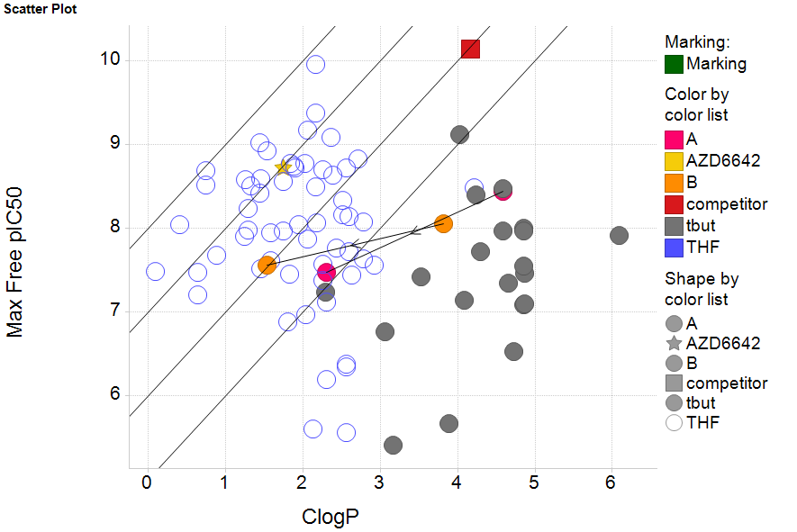
AZD6642 identified to meet the criteria for an oral once daily dosed drug candidate for further evaluation
LLE driven design → Access to new property space
LLE= 8 7 6 5
hWB_{free}
pIC50

Slide 24
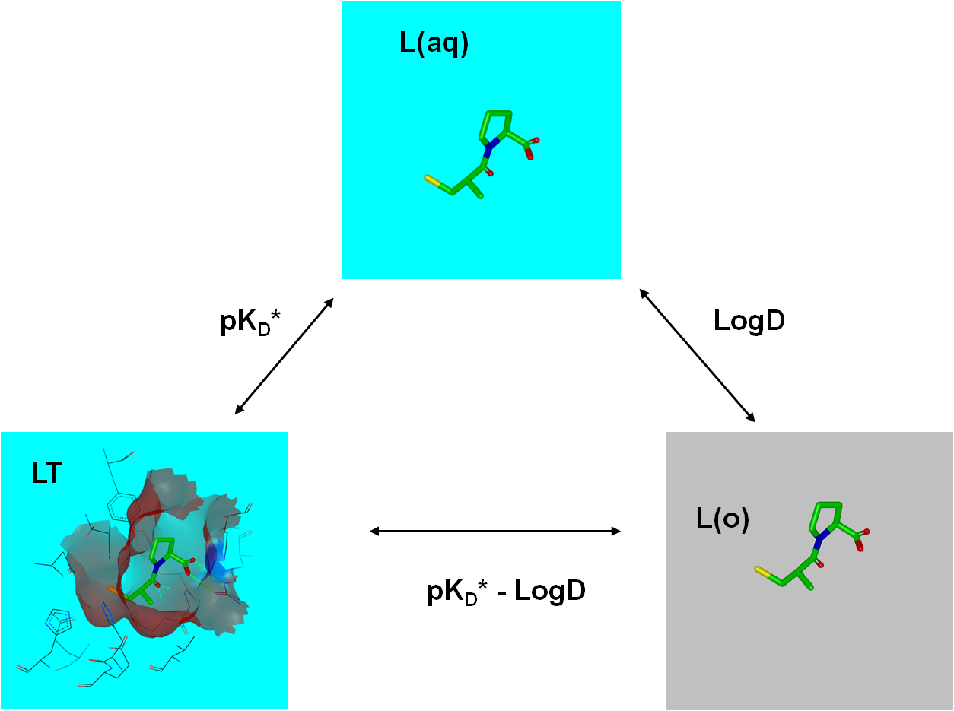
LLE as measure of ligand binding specificity - Thermodynamic cycle representation
does the ligand bind because it likes the target or because it hates the water?
Differences in LogD is often assumed to be dominated by water chemical potental
(LLE)
The physical meaning of LLE is to shift the reference state from water to octanol

Slide 25
Physically relevant measures of specificity
Specificity= µ^{LT} - µ^{Lw}
Measures how much the compound likes the target compared to water
Isolated target irrelevant when comparing between ligands (ΔΔG) → best measure of general ”specificity” and promiscuity”?
LLE= µ^{LT} - µ^{Loct}
Measures how much the compound likes the target compared to octanol
LLE
∆H[L(w)→L(o)]≈T∆S[L(w)→LP(w)]
requirement for enthalpic optimization to equal optimizing for LLE

Slide 26
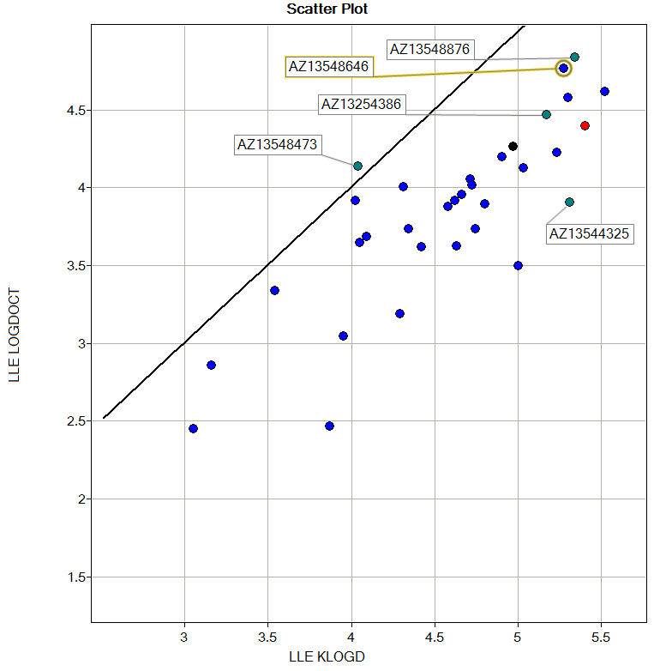
LLE – what measure of lipophilicity should one use?
LLE using different LogD’s may lead to different conclusions
the chemical potential in the aqueous phase is the thermodynamically a more sensible reference point than e.g. 1-octanol
Can be beneficial to use several different measures of lipophilicity
Interaction potential can be deconvluted into e.g. Hbond donors and acceptor propensities
1 LLE unit
Project example FLAP

Slide 27
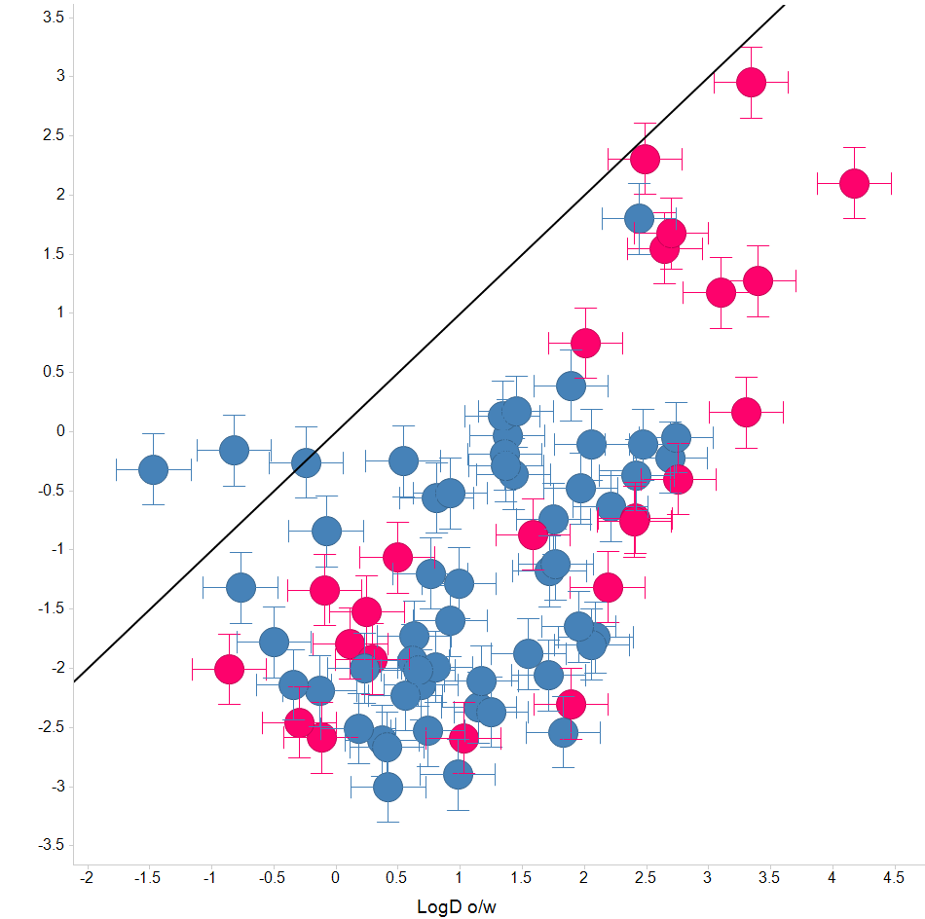

Is LogD a good reference for promiscuity?
LogD Octanol/Water vs LogD Hexane/water
Water/octanol system introduced to mimic membrane environment
Not a unique reference system but is used for general composites e.g. LLE
Compounds typically ”like” octanol more than Hexane
”DMPK” is a diverse set of compounds used in validation of DMPK assays
”Frag” =small fragments (1-2 rings) with diversity in polar interactions
LogD h/w
LogD o/w

Slide 28
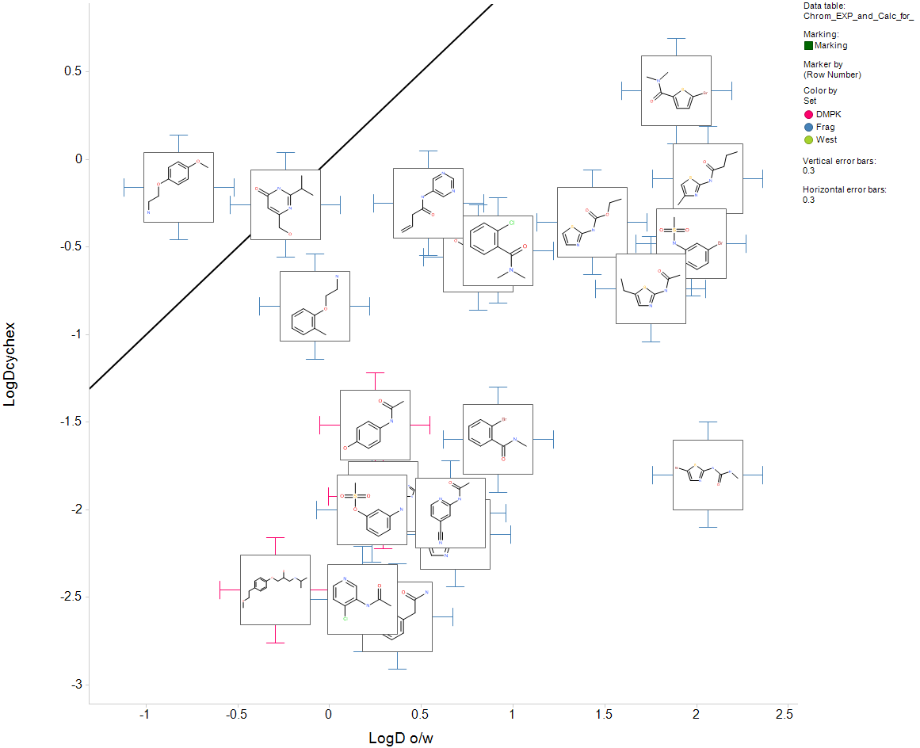
LogD Octanol/Water vs LogD Hexane/water
Fragments only containing one ring
LogD h/w is expected to be more directly related to chemical potential in water
→ LogD h/w should be more related to general promisquity
LogD o/w still more important for promisquity in membrane exposed sites?
Compounds with very similar size and overall heteroatom makeup can have large differences in interactions with octanol → implications for LLE
Δ=2.5
LogD h/w
LogD o/w

Slide 29
Final Notes
In vitro data often have large signals from physicochemical properties
These signals cancels out in the body
Machine learning models will often pick up these signals leading to optimization of irrelevant properties
Neither LLE nor Enthalpy are endpoints but LLE is more directly related to binding specificity
LLE is conceptually appealing but typically contains spurious contributions
New Rule - Predictions of affinity should always be benchmarked with simple models using contributions from solvent interactions
Notes:
Enthalpy optimization is challenging - difficulty to interpret data mechanistically without extensive information from crystals and simulations
Neither LLE nor Enthalpy are endpoints but LLE is more directly related to binding specificity
Combination of LLE and Enthalpy/Entropy profiling can provide vital information to identify different binding modes
LLE is conceptually appealing but typically contains spurious contributions
New Rule - Predictions of affinity should always be compared with contributions from solvent interactions
Chemical potentials are the driving force

Slide 30
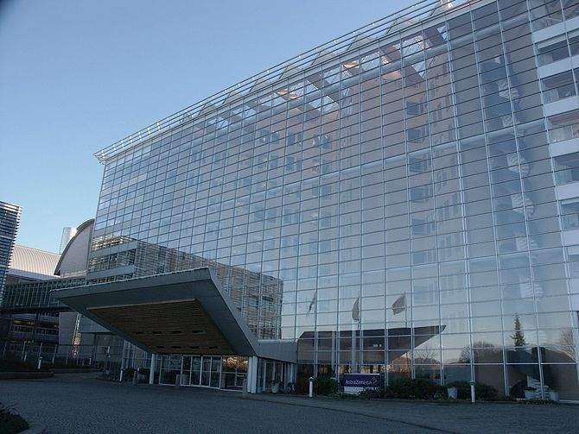
Acknowledgements
Patrik Johansson - Discovery Sciences AstraZeneca
Stefan Geschwindner - Discovery Sciences AstraZeneca
Fredrik Bergström - CVMD AstraZeneca
ITC Membrane project X & BACE: Per Hillertz; Thrombin: Helena Danielsson, Johan Winquist (Uppsala University)
Numerous colleagues from projects (FLAP,CDK5, BACE, Thrombin) (Mölndal, Wilmington, Södertälje site)

Slide 31

Thank you for listening

